Slide 1


Welcome!

Slide 2

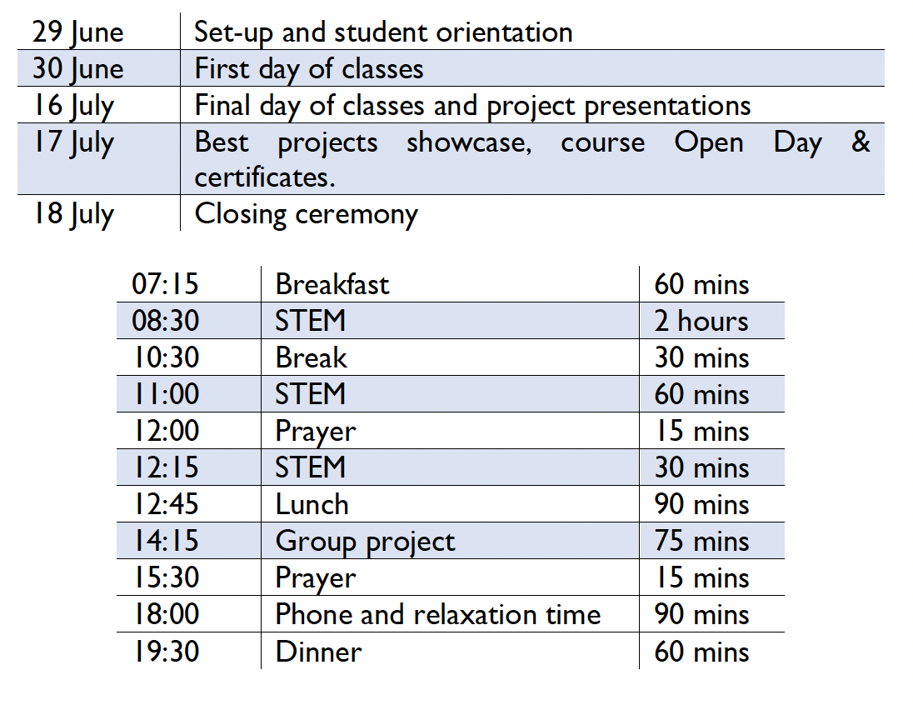

Course introduction
29th June – 18th July 2024 (3 weeks)
Tutor: Mr Omar Choudhry
Please review the Pre-course Student Handout
Establish Teaching Pedagogies
Course: Cybersecurity and Cryptography
Final Group Project Introduction
Notes:
This is the 8th annual collaboration between Mawhiba and Oxmedica, a testament to the
exclusivity and prestige of our flagship summer program. Held in the Kingdom of Saudi Arabia
since 2016, this year's program boasts a record number of enrolled students, approximately
500 across the male and female programs. As students, you are not just participants, but part
of an elite group within the top 1% of aspirational and ambitious high school students. Mawhiba
is a programme established by King Saud’s (rahimahullah) Education is a cornerstone of Prince Salman’ (hafidhahullah)
Vision 2030, and this program is a key part of it. A core ambition of Vision 2030 is to
build an independent economy away from the petroleum industry. Part of that is to educate
children to grow up to have thriving businesses and careers in wider industries – of which
education is an integral foundation.
As part of Oxmedica, we are committed to making a lasting impact on STEM (scientific,
technological, engineering, and mathematical) knowledge. We aim to inspire the next
generation and offer them a unique experience that will shape their future. We are a global
team of experienced academic, research, and career professionals. This will be a high-intensity,
bespoke academic program aimed at aspirational high school students spanning an extremely
important core STEM discipline – Cybersecurity and Cryptography. You will not only gain
theoretical knowledge but also have a series of immersive, impactful and academically rigorous
lectures and workshops specially designed to enhance every student's personal character and
subject knowledge, setting you up for a successful future in the field.
Through Mawhiba, you will have a teaching assistant who will assist throughout this
programme. They will assist with lessons, field trips, and equipment planning. You will also
have a residential assistant (between each student group of 8-10 students). They are university
students who will help manage logistics such as getting to/from classrooms and restaurants,
dealing with accommodation matters, checking in, and any enrichment and weekend activities.
Teaching Pedagogies
We expect you as students, individually and collectively, to be well-mannered and wellbehaved,
trying your best to do the work to the best of your ability. We expect you to listen
when tutors and instructors speak and only speak when instructed. There will be no assigned
homework – please maintain a good work/life balance, and there is no need to do extra work
outside of the classroom.
Lectures will not be very long unless necessary. There will be many substantial activities – lab
work, demonstrations, group discussions, competitions, creative work, debates, workshops
and potentially a guest lecture. You are expected to engage in scheduled debates, complete
worksheets, pay attention to and make notes to lectures, present in group and individual
presentations, and ask questions in question-and-answer sessions. Lessons will always end with
key messages and learning points. Regarding classroom management, please be prompt and
punctual. Breaks will be provided where necessary.
The focus is on having a clear trajectory and strong motivation from the outset. The goal is
not to impart as much theoretical knowledge as possible but on skills, building in practical and
applied elements where possible. We aim to inspire, intrigue, and encourage dialogue in one
of the most forefront fields in the tech world.
Timetable
3.5 hours x 12 days + 2 hours x 1 day = 44 hours
30 core topics, 9 specialist topics, 3.5 field trip, 0.5 course survey, 1 intro

Slide 3
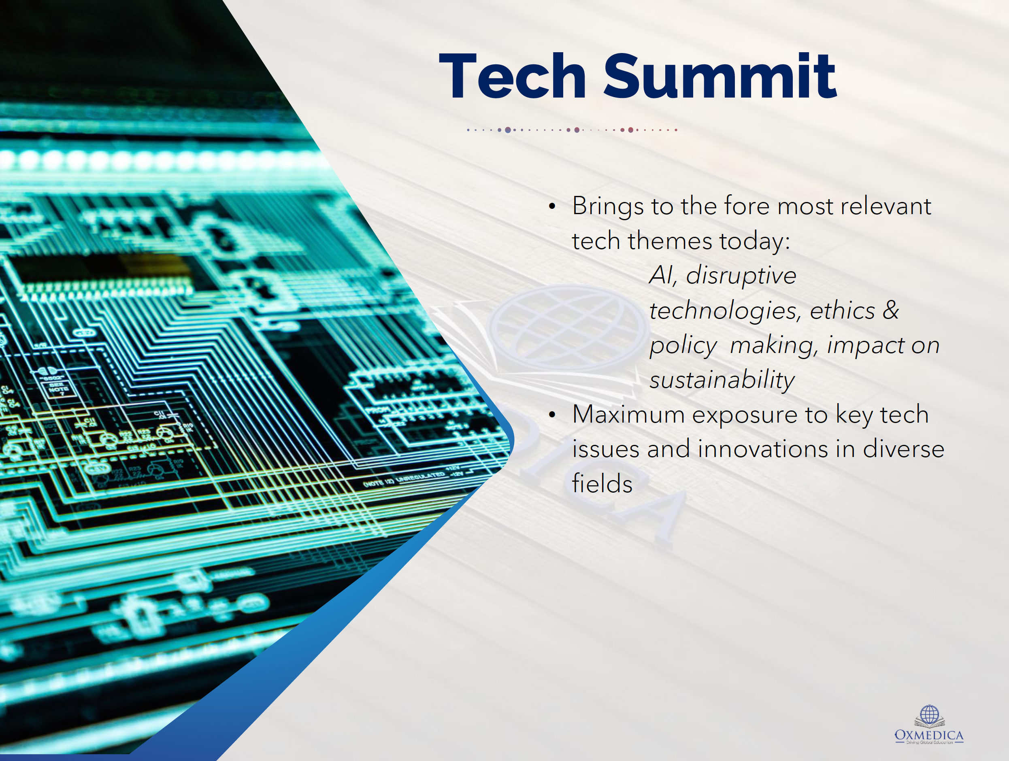
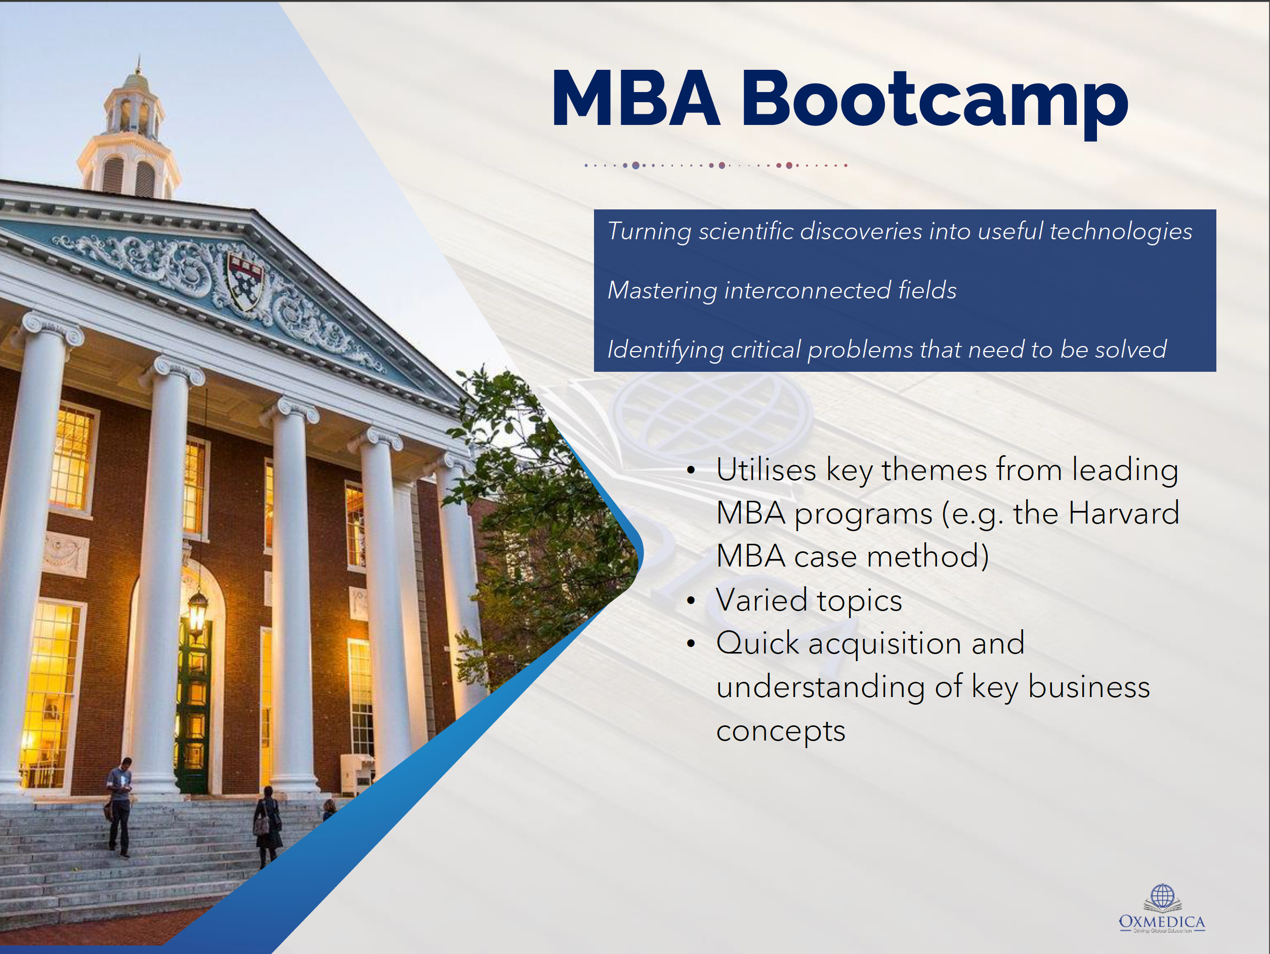
Notes:
In addition to academic learning, you will also have an opportunity to attend an MBA Bootcamp
and Tech Summit.
The MBA Bootcamp focuses on turning scientific discoveries into useful technologies,
mastering interconnected fields, and identifying critical problems that need to be solved. It will
also focus on utilising key themes from leading MBA programs (e.g., the Harvard MBA case
method), varied topics, and quick acquisition and understanding of key business concepts.
The MBA Bootcamp will be on Saturday, July 6, during Week 1

Slide 4

Notes:
The Tech Summit addresses the foremost relevant tech themes today: AI,
disruptive technologies, ethics and policy-making, impact on sustainability, and maximum
exposure to crucial tech issues and innovations in diverse fields.
As your tutor, I will deliver a talk at the Tech Summit, “A New Age Of Fabrication”. I will hope
to cover 3 main topics: Fake News (how AI algorithms can generate realistic but entirely
fabricated news articles and videos, influencing public opinion and potentially swaying
elections), Social Media Echo Chambers (amplification of misinformation and creating polarised
communities) and Deepfakes (from explicit content to professional theft sand falsified religious
verdicts)
The Tech Summit on Saturday, July 13, during Week 2.

Slide 5

Course outcomes
Career Paths in Cybersecurity
Critical Cybersecurity Case Studies
Architecture of Computers
Database Systems
Cryptographic Techniques
Network Security Concepts
Cybersecurity Legislation and Regulation
Hacking and Cyber Attacks (Cyber Attacks, Malware and Viruses, Threat-Vectors and Threat Agents)
Specialist Topics (Advanced Coding, Data Science, Artificial Intelligence)
Final Group Project
Notes:
This course will introduce you to fundamental components of computer science with a
particular focus on key tenets of cybersecurity and cryptography. Students will begin by
understanding the basic language and architecture of computers, networks, and database
systems and will investigate the different possible security threats that computer systems
confront. You will consider what value your private data might hold for organisations and how
organisations might use this data in nefarious ways without seeking your permission. Students
will then look at social engineering techniques cybercriminals use to trick users into giving
away their personal data. The course then turns its attention to more common cybercrimes
such as hacking, DDoS attacks, and malware and considers methods to protect themselves
and our networks against these attacks. You will also learn the basics of cryptography and how
to encode and decode using ancient and modern cyphering techniques. Students will undergo
regular individual/group-based class exercises to implement their learning in various cyber
threat scenarios.
After taking this course, students will be able to:
• Encrypt and decrypt messages using a variety of cyphering techniques
• Describe the basic structure of computer networks and the most common ways in which
these networks may be attacked
• Code and debug simple cybersecurity software without assistance
• Understand the role of cybersecurity in business and government
• Project themselves into the day-to-day lifestyle of a cybersecurity professional and have a
sense of whether a career in cybersecurity is right for them
This course will approach computer security through a systems thinking lens. Each lesson will
build on the previous to construct a complete understanding of how the Internet works and
how it can be exploited. Starting with the application level, we will fully understand the systems
that support the Internet infrastructure.
3.2 Course Trajectory
Cybersecurity is a discipline within computer science that identifies weaknesses and develops
defences for systems, networks, and programs against attacks.1 The primary objective of
cybersecurity specialists is to develop technologies into robust systems that protect the user.
This course is designed to provide an introduction to the discipline of cybersecurity
complimented with a foundational understanding of computing necessary to deeply understand
security. The course is structured to first address the components and architecure of
computers such as your laptop or mobile phones. Within each class period, we will expand
the scope to include another component of a complete system such as the internet. With each
topic, the class will utilise an attacker mindset to execute attacks and identify vulnerabilities in
technologies in order to create more robust defences.
Cybersecurity is a discipline within computer science that identifies weaknesses and develops
defences for systems, networks, and programs against attacks.1 The primary objective of
cybersecurity specialists is to develop technologies into robust systems that protect the user.
This course is designed to provide an introduction to the discipline of cybersecurity
complimented with a foundational understanding of computing necessary to deeply understand
security. The course is structured to first address the components and architecure of
computers such as your laptop or mobile phones. Within each class period, we will expand
the scope to include another component of a complete system such as the internet. With each
topic, the class will utilise an attacker mindset to execute attacks and identify vulnerabilities in
technologies in order to create more robust defences.
The goal of this course is to ignite the student’s interest in cybersecurity and increase
computational competency. In addition to technical skills, this course will provide greater
information about the cybersecurity career pathway which offer highly dynamic and in-demand
opportunities. diagrams), and the physical presentation (25%, based on delivery and communication skills,
time management, and answering questions).
Specialist Topics
You will have the opportunity to benefit from some of my specialisms in this course in the
final week of the programme. As mentioned in my tutor information, my key areas are within
artificial intelligence.
Machine learning and the whole artificial intelligence field are so important that it is integral to
teach students what this is and how it works so that it isn’t just a mystery. The applications
are endless, and we will make sure to show how we can apply ML and AI to cybersecurity and
cryptography with practical examples.
Given that only 9 hours of course time is available to teach these topics, the goal would be to
equip students with the most practical knowledge and develop their skills within this limited
time. Even though there are many, it is essential to discuss aspects of each so that students
are aware of what exists in the real world and what is used in industry.
Final Group Project
You will work for roughly 75 minutes daily on a final project of about 4 or 5 students. You
will be paired up with students from the Mechanical Engineering course.
You will be designing a secure, sustainable power grid.
STEM group project: Designing a secure sustainable power grid. This project will involve two core aspects: designing a sustainable power grid using renewable energy sources and a relevant, robust cybersecurity framework. The cybersecurity aspect will consider secure communication channels, encryption of data transmissions, and authentication protocols for grid access and control. The engineering aspect will focus on creating a sustainable energy source that could be developed within Saudi Arabia. It will consider the process of collecting, storing, and converting energy to electricity, but mainly transportation of the energy, thinking about the required physical infrastructure.
Certain aspects need to be considered, such as what happens in the case of an actual attack and what fail-safes are in place, energy-specific issues such as solar only working during clear day-time or safety and economic challenges for nuclear power plants, geographical locations, challenges with integration into any existing electrical grid and political challenges. Also, evaluate if a distributed power grid is better than a single large power plant (a grid generally has more redundancy, but the probability of a successful attack increases due to the increased connections in the notebooks and with a larger number of physical locations). This project will be interesting for the students as it combines both disciplines in an extremely relevant field, constituting various principles and ideas from both courses.
The main deliverables and forms of assessment will be a 4-page report (50%, based on application of technical knowledge, relevance to the real-world, novelty and innovation, organisation and clarity), a set of slides (25%, based on clarity, conciseness, use of media and diagrams) and the physical presentation (25%, based on delivery and communication skills, time-management and answering questions).
Remember that the final product must have a strong oral component with visual aids (pitch,
proposal, presentation, …) with a maximum time limit of 10 minutes per group. We will have
combined in-class group project presentations on 16 July, and then the best groups from all
courses (just 1 group for our course) will showcase their projects on 17 July.

Slide 6


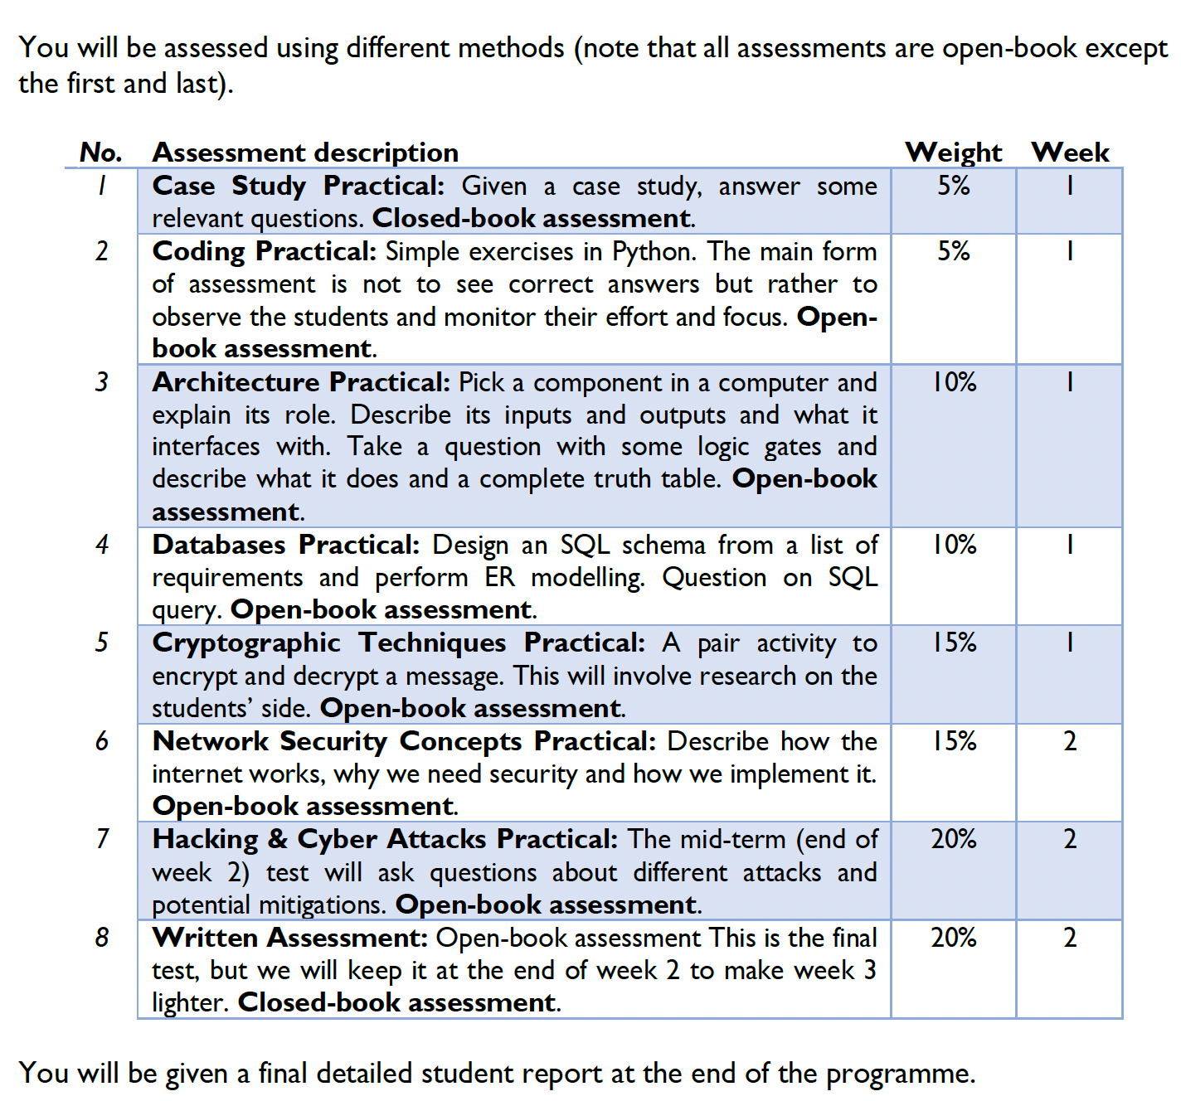
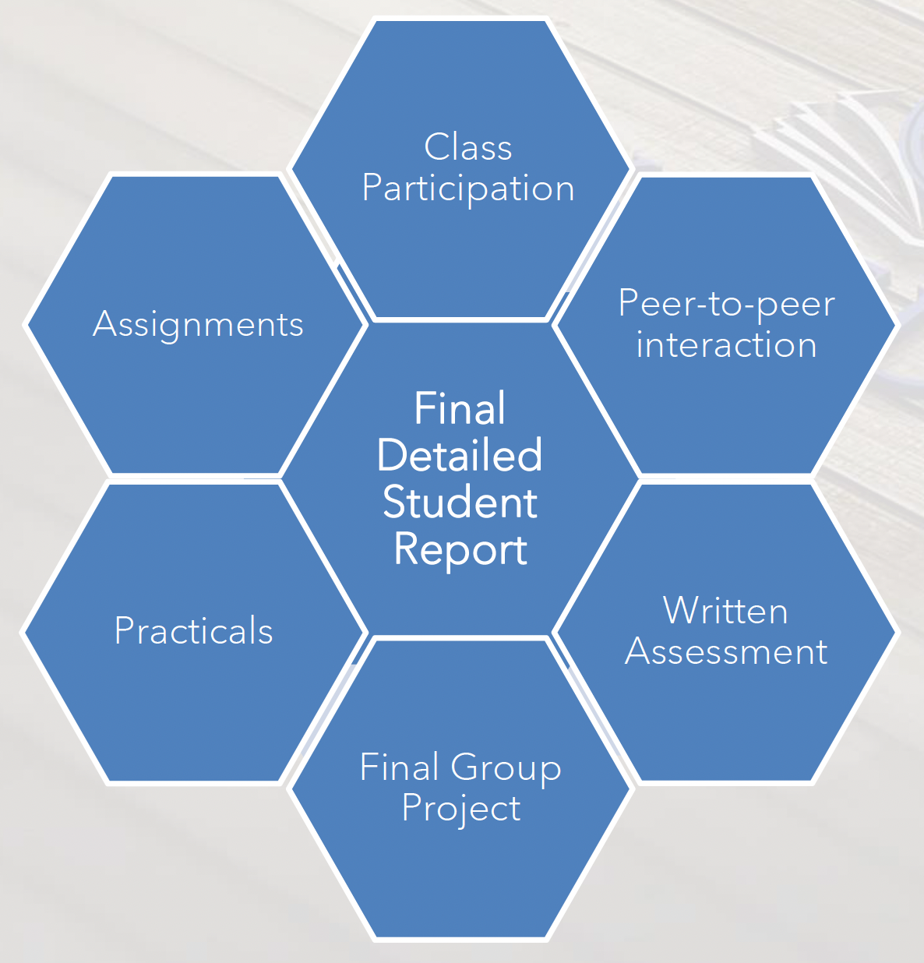
Assessment

